Slide 1
STUDENT’S T-TEST
USED TO TEST AND COMPARE TWO SMALL SETS OF QUANTITATIVE DATA WHEN SAMPLES ARE COLLECTED INDEPENDENTLY OF ONE ANOTHER.

Slide 2
CONTENTS
HISTORY
INTRODUCTION
TYPES OF T TESTS
NECESSARY CRITERIA
MATH BEHIND T TEST
ACCEPTANCE CRITERIA BASED ON T VALUE
ACCEPTANCE CRITERIA BASED ON P VALUE
ABOUT THE DATASET
APPLICATIONS
LIMITATIONS
CONCLUSION

Slide 3
HISTORY
In 1908, William Sealy Gosset Developed the T test.
He worked at the Guinness Brewery Company and he developed this test to determine the difference between barley yield which is a main ingredient in beer
He wanted to share this to all the fellow statisticians but the brewery didn’t want him to publish as it was considered as company’s secret
He finally convinced them but he have to publish under the pseudo name STUDENT

Slide 4
INTRODUCTION
A Student t-test is defined as a statistic method and this is used to compare the means of two different populations.
It is a method that is often used in hypothesis testing to find out whether a process or whether a given treatment actually has any effect on the population of interest, or whether or not two populations are different from each other.
A t test can only be used when comparing the means of two groups.If you want to compare more than two groups ,ANOVA test is used

Slide 5
TYPES OF T TESTS
ONE - SAMPLE T-TEST
TWO - SAMPLE T-TEST
ONE TAILED T-TEST
TWO TAILED T-TEST
PAIRED T-TEST

Slide 6
The most frequently used t-tests are one-sample and two-sample tests:
A one-sample location test of whether the mean of a population has a value specified in a null hypothesis
A two-sample location test of the null hypothesis such that the means of two populations are equal. All such tests are usually called Student's t-tests, though strictly speaking that name should only be used if the variances of the two populations are also assumed to be equal; the form of the test used when this assumption is dropped is sometimes called Welch's t-test. These tests are often referred to as unpaired or independent samples t-tests, as they are typically applied when the statistical units underlying the two samples being compared are non-overlapping.

Slide 7
CRITERIA
Only if there is a direct relationship between each specific data point in the first set and one and only one specific data point in the second set, such as measurements on the same subject 'before and after,' then the paired t test MAY be appropriate.
If samples are collected from two different populations or from randomly selected individuals from the same population at different times, use the test for independent samples (unpaired).
Here's a simple check to determine if the paired t test can apply - if one sample can have a different number of data points from the other, then the paired t test cannot apply.

Slide 8
HYPOTHESES
The two hypotheses t-test are(applicable for both paired/unpaired t-test):
The null hypothesis (H0) states that there is no significant difference between the means of the two groups.
The alternative hypothesis (H1) states that there is a significant difference between the two population means, and that this difference is unlikely to be caused by sampling error or chance.
Ho:μ1≠μ2
H1:μ1≠μ2

Slide 9
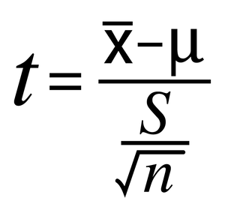
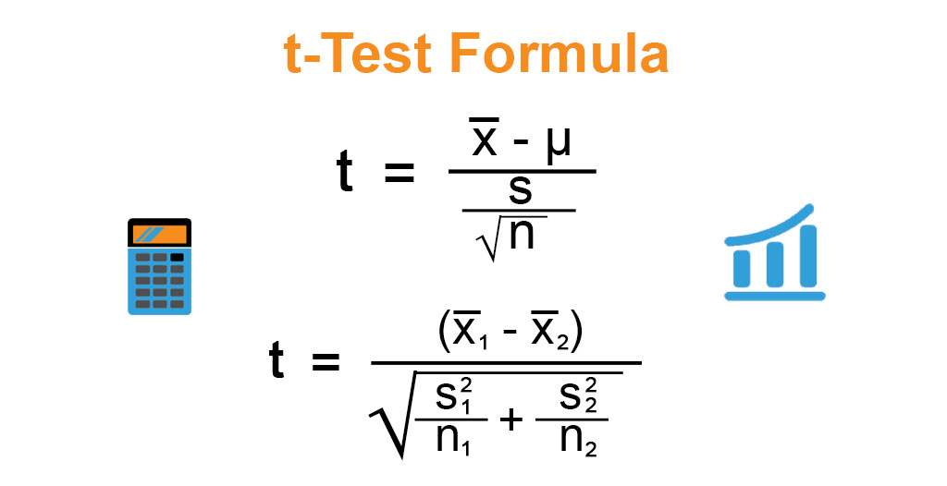
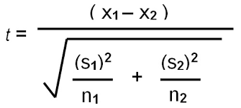
Math behind t TEST
T-value is defined as the ratio of Signal to noise
T-Value= Signal/Noise
Signal difference between the group means(X1-X2)
Noise variability of the groups
Variability describes how far apart data points lie from each other and from the center of a distribution
So T value is formulated as :
T-Value= Signal/Noise

Slide 10
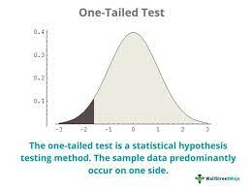
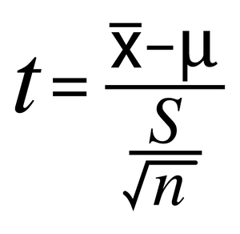
One-tailed t-test
A one-tailed test is a statistical test in which the critical area of a distribution is one-sided so that it is either greater than or less than a certain value, but not both.
In one tailed t-test,
the alternative hypothesis will be accepted instead of the null hypothesis.
Formula used is:

Slide 11
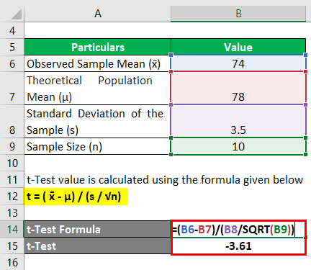
Example (one-sample test)
Let us take the example of a classroom of students that appeared for a test recently. A sample of 10 students was chosen from a total of 150 students. Calculate the sample’s t-test score if the mean score of the entire class is 78 and the mean score of the sample is 74 with a standard deviation of 3.5. Also, comment on whether the sample statistics are significantly different from the population at a 99.5% confidence interval.
t-Test Formula-1.1
Solution:
t-Test value is calculated using the formula given below:
t = ( x̄ – μ) / (s / √n)
t-Test Formula-1.2
t = (74 – 78) / (3.5 / √10)
t = -3.61
Therefore, the sample’s absolute t-test value is 3.61, which is less than the critical value (3.69) at a 99.5% confidence interval with a degree of freedom of 9. So, the hypothesis of the sample statistic is different than the population and can be rejected.

Slide 12
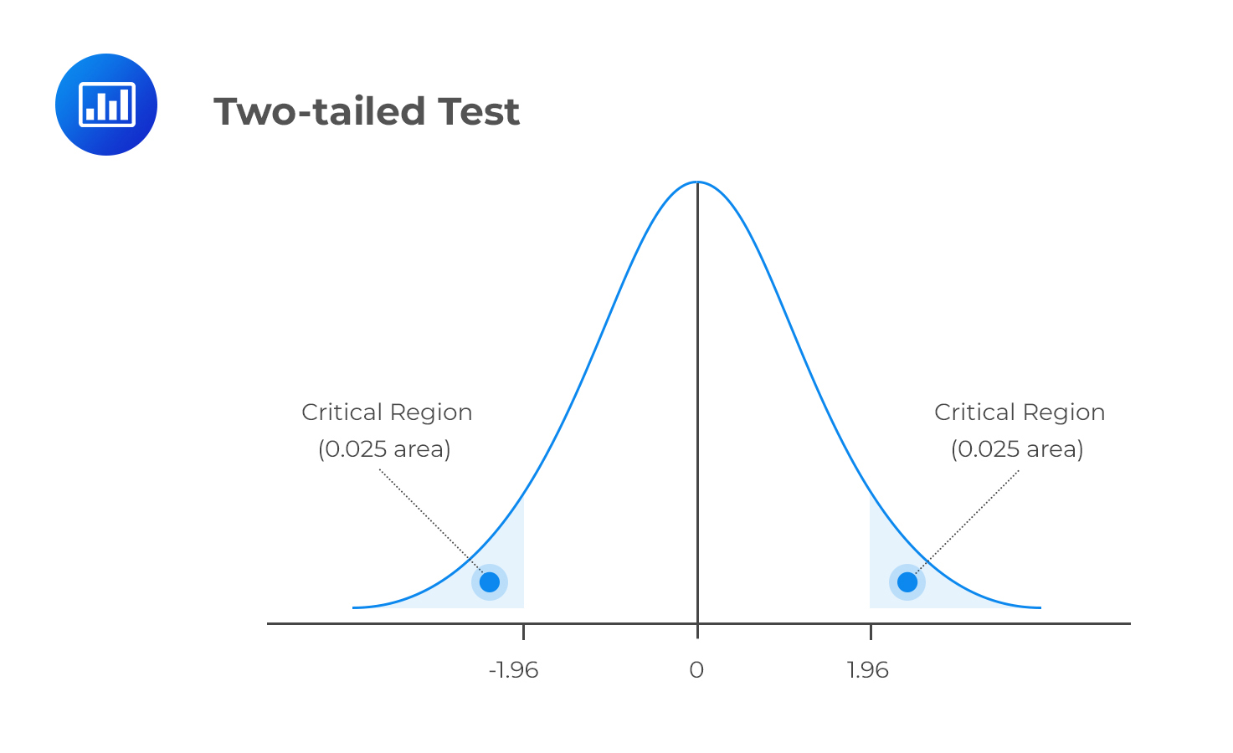
Two tailed t-test
A two-tailed test, in statistics, is a method in which the critical area of a distribution is two-sided and tests whether a sample is greater than or less than a certain range of values.
It is used in null-hypothesis testing and testing for statistical significance.
Formula used is:

Slide 13
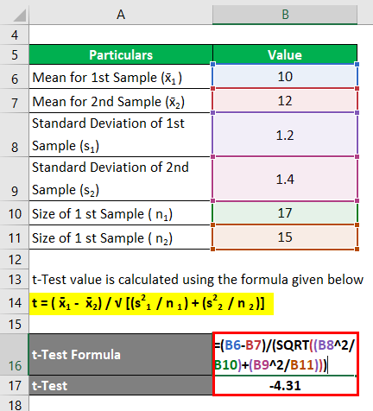
Example (two-sample test)
Let us take the example of two samples to illustrate the concept of a two-sample t-test. The two samples have means of 10 and 12, standard deviations of 1.2 and 1.4, and sample sizes of 17 and 15. Determine if the sample’s statistics are different at a 99.5% confidence interval.
Calculate sample's statistics
Solution:
t-Test value is calculated using the formula given below
t = ( x̄1 – x̄2) / √ [(s21 / n 1 ) + (s22 / n 2 )]
Calculation of t Value
t = (10 – 12) /√ [(1.22 / 17) + (1.42 / 15)]
t = -4.31
Therefore, the absolute t-test value is 4.31, which is greater than the critical value (3.03) at a 99.5% confidence interval with a degree of freedom of 30. So, the hypothesis that the statistics of the two samples are significantly different can’t be rejected.

Slide 14
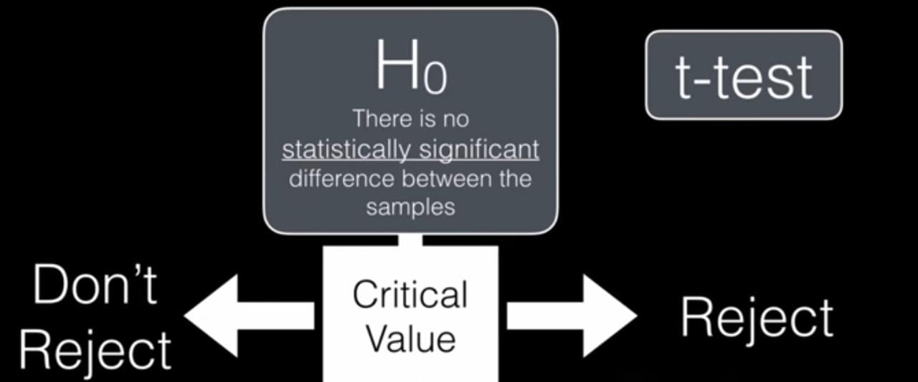
ACCEPTANCE CRITERIA BASED ON T VALUE
The Null Hypothesis H₀ is accepted when the t value is less than the critical value.
T value < Critical value (Accept Null hypothesis H₀ )
If the t value is greater than the critical value then we accept the Alternate hypothesis
T value > Critical value (Accept Alternate hypothesis H_{a})

Slide 15
ACCEPTANCE CRITERIA BASED ON P VALUE
The Null Hypothesis H₀ is accepted when the p value is Greater than the level of significance.
P value > α Level of Significance (Accept Null hypothesis H₀ )
If the p value is less than the α Level of Significance then we accept the Alternate hypothesis.
P value < α Level of Significance (Accept Alternate hypothesis H_{a})

Slide 16
About the dataset(Golf ball testing data set from Par Inc)
Par Inc., is a major manufacturer of golf equipment. Management believes that Par’s market share could be increased with the introduction of a cut-resistant, longer-lasting golf ball. Therefore, the research group at Par has been investigating a new golf ball coating designed to resist cuts and provide a more durable ball.
The tests with the coating have been promising. One of the researchers voiced concern about the effect of the new coating on driving distances. Par would like the new cut-resistant ball to offer driving distances comparable to those of the current-model golf ball.
To compare the driving distances for the two balls, 40 balls of both the new and current models were subjected to distance tests. The testing was performed with a mechanical hitting machine so that any difference between the mean distances for the two models could be attributed to a difference in the design.

Slide 17
APPLICATIONS
One Sample t-tests in Real Life
1: Manufacturing
A manufacturing engineer wants to know if some new process leads to a significant improvement in mean battery life of some product.
To test this, he measures the mean battery life for 50 products created using the new process and performs a one sample t-test to determine if the mean battery life is different from the mean battery life of products made using the current process.
2: Medicine
A doctor may want to know if some new drug leads to a significant reduction in blood pressure compared to the current standard drug used.
To test this, he recruits 20 subjects to participate in a study in which they each take the new drug for one month. He can perform a one sample t-test to determine if the mean reduction in blood pressure is significantly greater than the mean reduction that results from the current standard drug.

Slide 18
APPLICATIONS
Independent Two Sample t-tests in Real Life
1: Studying Techniques
A professor wants to know if two studying techniques lead to different mean exam scores.
To test this, he assigns 30 students to use one studying technique and 30 students to use a different studying technique in preparation for an exam. He then has each student take the same exam. He can use an independent two sample t-test to determine if the mean is different between the two groups.
2: Weight Loss
A dietician wants to know if two different diets lead to different mean weight loss amounts.
To test this, she assigns 20 subjects to use diet A for one month and 20 subjects to use diet B for one month. She then measures the total weight loss of each subject at the end of the month. She can use an independent two sample t-test to determine if the mean weight loss is different between the two groups.

Slide 19
LIMITATIONS
We can examine the assumptions of t-test, so the limitations are clear. When data violates the assumptions, t-test might not have reliability.
Assumptions include:
The scale of measurement: The assumption for a t-test is that the scale of measurement applied to the data collected follows a continuous or ordinal scale, such as the scores for an IQ test..
Random sampling: The data is collected from a representative, randomly selected portion of the total population.
Data is normally distributed.
The two population have the same variance. This can be adjusted though.

Slide 20
Conclusion
Statistical research and data analysis apply t-tests to evaluate whether the differences that appear within a sample group occur by chance.
The test measures the mean of a sample group and compares it with other averages to determine the likelihood of achieving similar results.
You can also conduct a t-test for comparing and predicting outcomes, which can be beneficial for many applications outside of data and computer science

Slide 21
The results achieved after the t-test are useful for concluding if they are actually correct, they can be applied to the entire population.
Since the small sample size is needed for calculation, it not only saves on money but saves on the time required to collect and analyze large amounts of data.

Slide 22
THANK YOU
Varanasi Naga Sai Pranav Akhilesh
CSE Department
UCEK JNTUK

